Slide 1
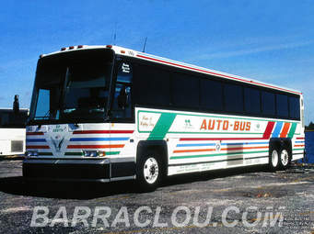
A Project Presentation On
SKY SHINER
TRANSPORTATION
Submitted By:
Sakshi
Km Iti Agrawal

Slide 2
1.
Introduction
2.
Problem
Faced
Advantages and Disadvantages
CONTENTS
3.
Proposed Solution
6.
Data Flow Diagram
4.
Requirement
5.
Project Modules

Slide 3
Introduction
This is an application which will use to manage the Transportation Services (BUS) and maintain the Social Distancing.
This application is used to booking the seat of bus and also maintain Social Distancing.
In this app only 50% seats of a bus is booked.

Slide 4
Problem Faced
We all know that before COVID-19 there are no restriction or limit of seat allocation.
A lot of passenger are travel without having any seat. Buses are overloaded which effect on the passenger health.
But in current situation as we know social distancing is required. If buses are overloaded then affect of Corona virus got increased.

Slide 5
Proposed Solution
Solution of this problem is Sky Shiner Transportation.
Main Focus is to maintain Social Distancing.
It is an application which will give you permission to allocate your seat according to your comfort zone.
In this we will provide specific seat to you then you just need to book your seat before start your journey.
So all passenger will travel after booking their seat. So no one allowed to travel without having their own seat.
Digital payment method is also available.

Slide 6
Requirement
Hardware Requirements:
RAM: 512MB or higher
Processor: 1GHz or higher
Memory: 200 MB
Software Requirements:
Operating System: Android 4.1 or higher
Front-End: MIT App Inventor
Back-End: Firebase, Tiny DB1

Slide 7
Working of Sky Shiner
This is particularly use for manage Transportation Service.
In the Sky Shiner Transportation, we used 12 Screens

Slide 8
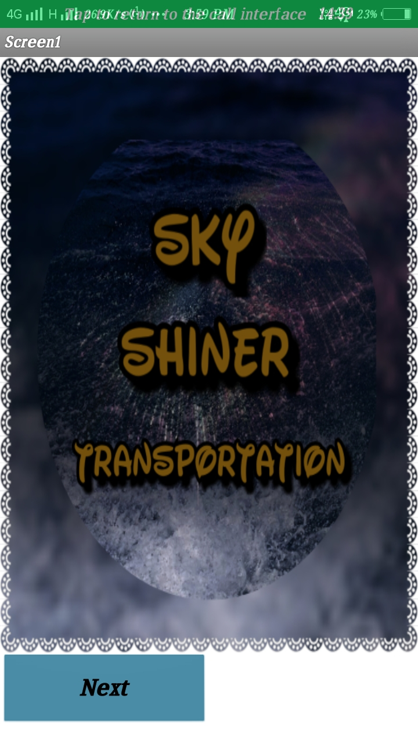
Screen 1
This is the First screen of SKY SHINER Transportation. In this we used an alert message and button that is Next. When we click on the next button then we will proceed on the second screen.

Slide 9
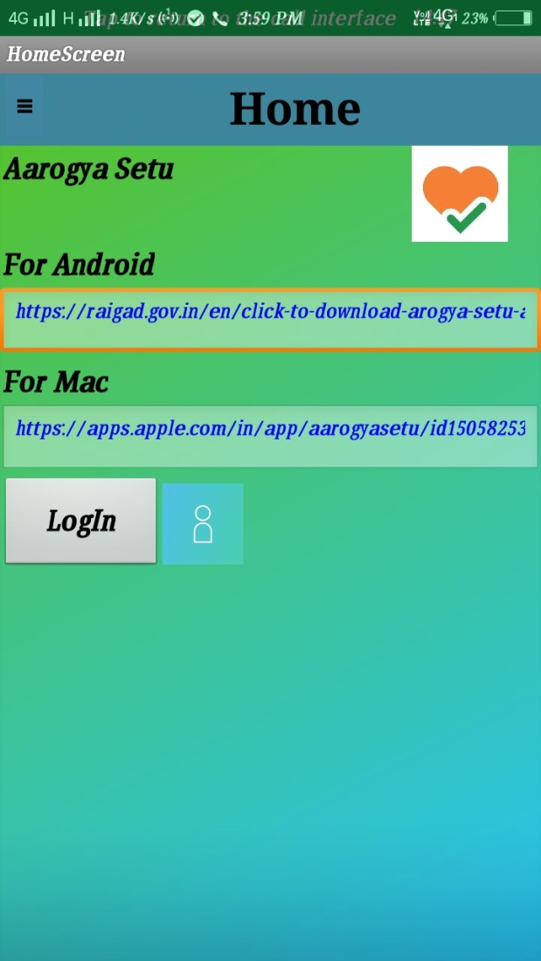
Screen 2
This is the second screen named Home Screen. In this screen we provide Aarogya Setu app URL for both Android and Mac as an authentication. We also provide two button that is Login and Menu Button Symbol (⭆). When you will click on Login button then you will go on the Login screen and when you will click on the Menu button then you will go on the Menu Screen.

Slide 10
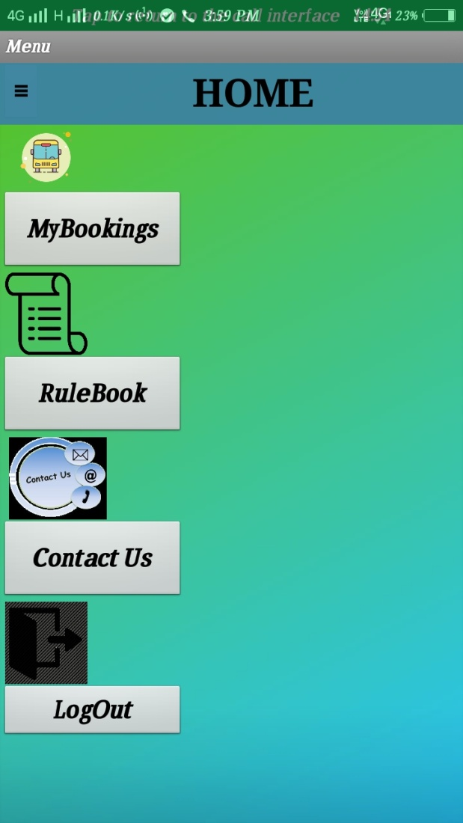
Screen 3
Name of this screen is Menu. In this screen we used 4 buttons that is My Bookings, Rules, Contact Us and Log Out.
When you will click on My Booking, Rules and Contact Us then you will go on another screen.
When you will click on the Log Out button the you will come out from the app.

Slide 11
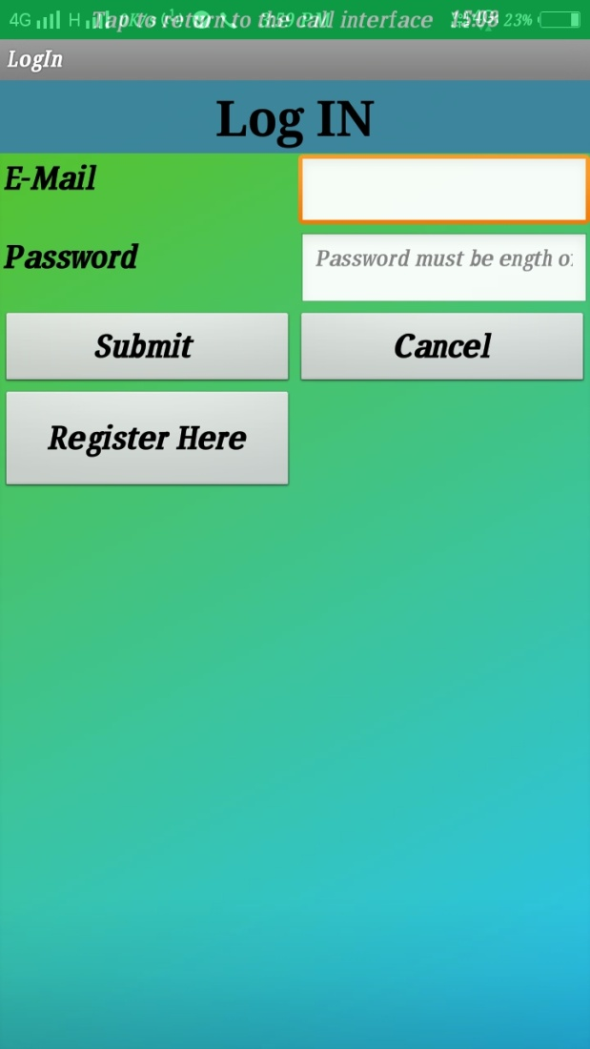
Screen 4
This screen name is Login. In this screen we used 3 buttons that is Submit, Cancel, Register Here and 2 textboxes for take the information. Firstly, you need to click on the Register Here button and after this you will go on the next screen that is Registration Screen. When you will do the Registration then you will come on the Login Screen. Then you need to fill all valid information which you provide at the time of registration. After give the all information you will click on the Submit button and you will come on another screen and when you will click on the Cancel button you will come on the Home Screen.

Slide 12
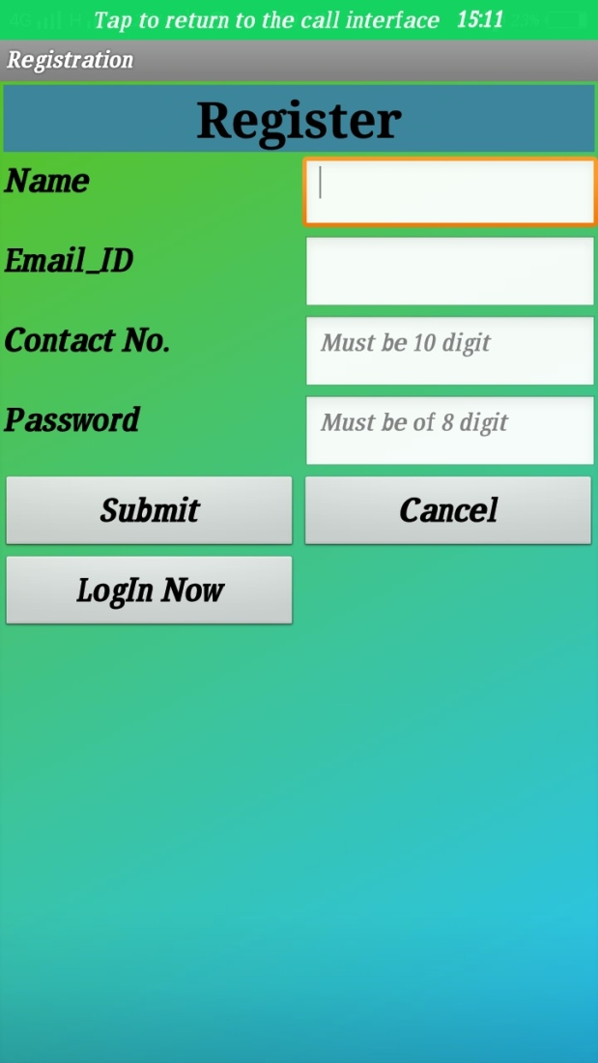
Screen 5
This is the 5th screen named Registration. in this we used 3 buttons that are Submit, Cancel and Log In Now. It also provides some textbox to take the information of the user. Firstly you need to fill all the fields according to the instructions and After this when you click on the submit button the you all information will be saved and when you click on the Cancel button you will come on the Home Screen. After Submitting your all details, when you will click on the Log In Now button you will come on the Log In page. In the Log In page when you will click on the Submit button you will jump on the next screen.

Slide 13
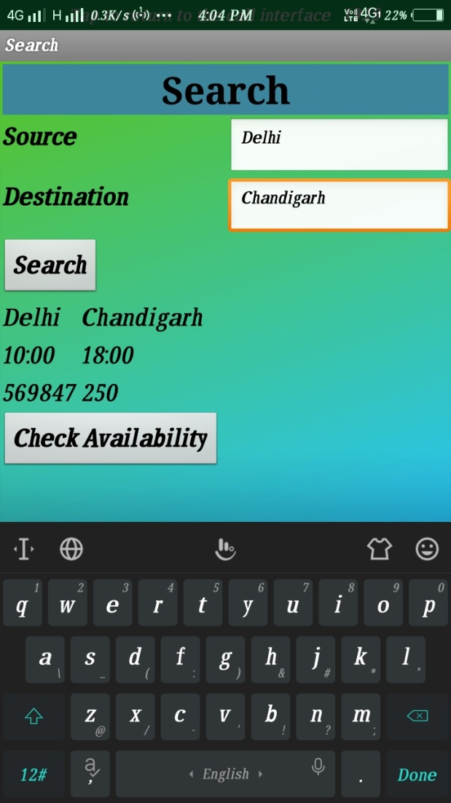
Screen 6
Name of this screen is Search. In this screen you just give the name of source and Destination according to your need. we used 2 buttons. First is Search button. In this, After fill the name of Source and Destination and then click on the search button you will see all data of the bus like Source, Destination , Arrived time, Departure time , Bus number, Fare from the firebase. Second is Check Availability. When you will click on this button you will go on the next screen.

Slide 14
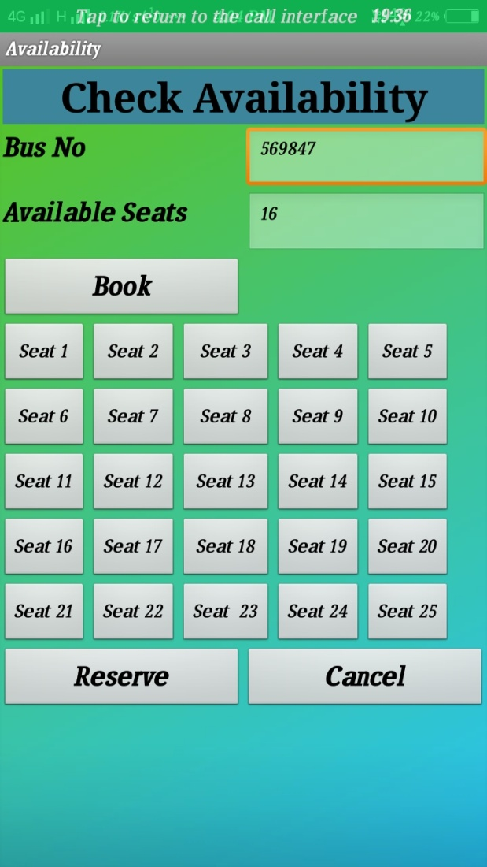
Screen 7
Name of the 7th screen is Availability. In this we will fetch the Bus Number and To Pay from the database but only you will see the Bus Number because in this To Pay is invisible for the users . We provides some buttons for the booking of seat. First button is Book. When you click on this button you will see all the seat number that are available. After this you will choose the seat which you want and click on the second button that is Reserve. After clicking on this button, you will come on the next screen. Third button is Cancel. After clicking on this button, you go back to the Home Screen.

Slide 15
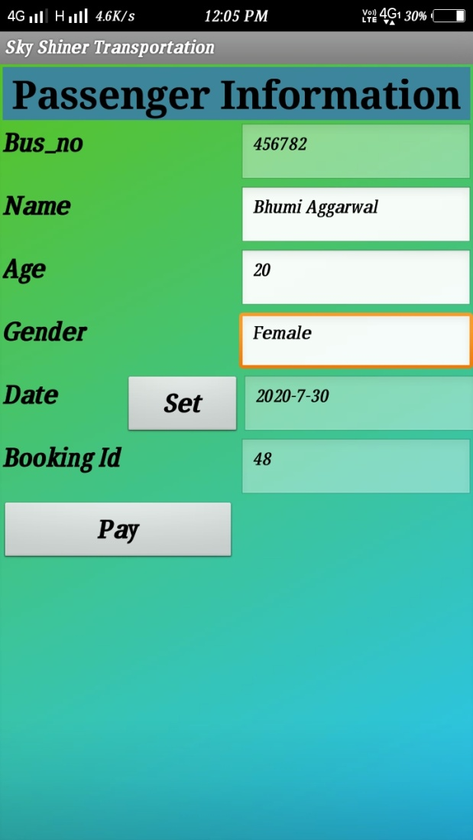
Screen 8
Name of this screen is Passenger info. It will take the information regarding passenger like as Name, Age, Gender etc. After filling all the information passenger need to click on the Pay button for the payment. When you click on this button you come on the next screen . Here To pay will invisible.

Slide 16
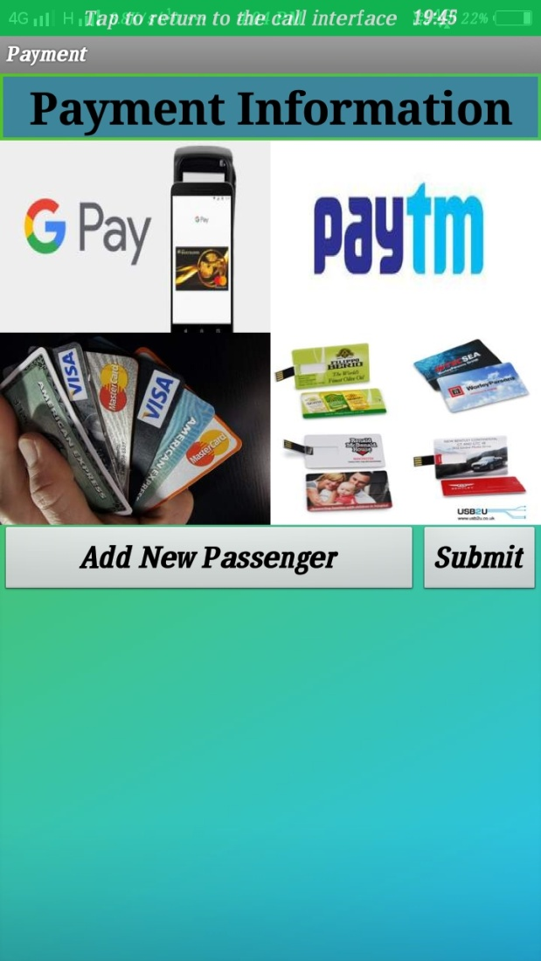
Screen 9
Name of the 9th screen is Payment Details. In this we had provided the option like G-Pay, Paytm, Debit card etc for the digital payment . it also has two buttons first is Add New Passenger and second is Submit. After payment, if you want to add another passenger then you will click on the Add New Passenger button and you will come on the passenger information page and you need to fill all the information which are require. If you want to proceed with the next page click on the Submit button.

Slide 17
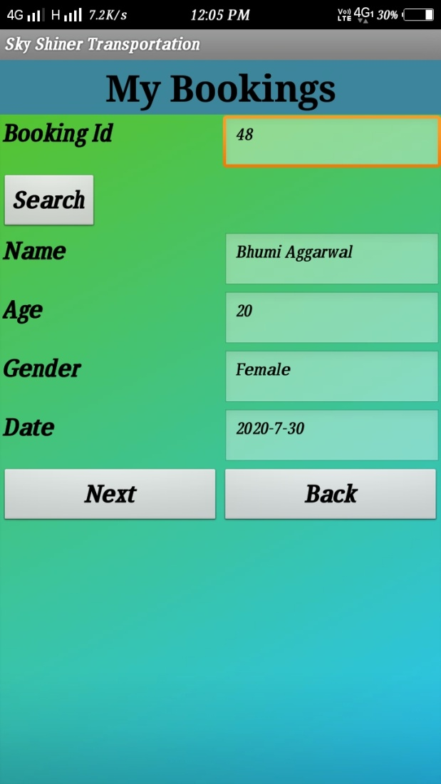
Screen 10
Name of this screen is My Bookings. It is work for the conformation of the booking of passenger seat. In this you will see all the information of the passenger which you fill in the previous section. All the data will be fetched from the Firebase . In this page you have three buttons. First is Search, second is Next and third is Back . When you will click on search button then you will able to see your all data in non editable format. If you have any query you will click on the Next Button but if you do not have any query you need to click on the back button . After clicking on the back button, you will come on the first page of the Sky Shiner Transportation.

Slide 18
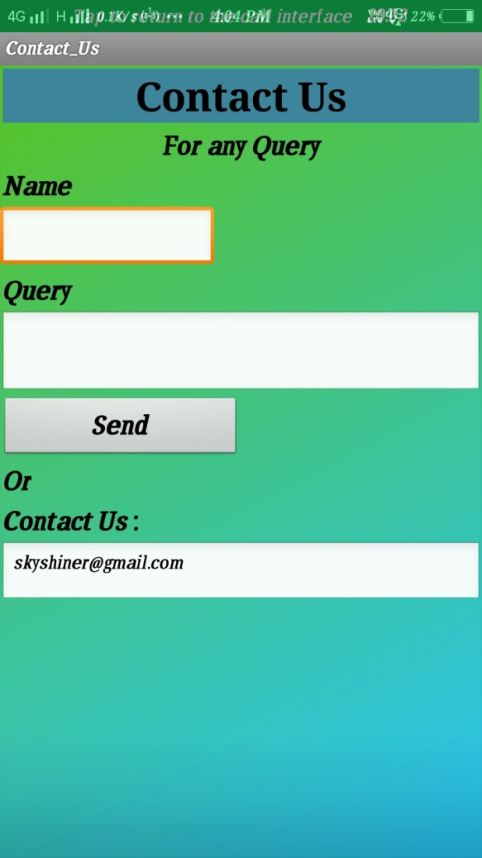
Screen 11
Name of the 11th screen is Contact Us. In this section if you have any query then you need to just give your name and send fill the query and click on the Send button. When you click on the Send button then your query will be submitted.

Slide 19
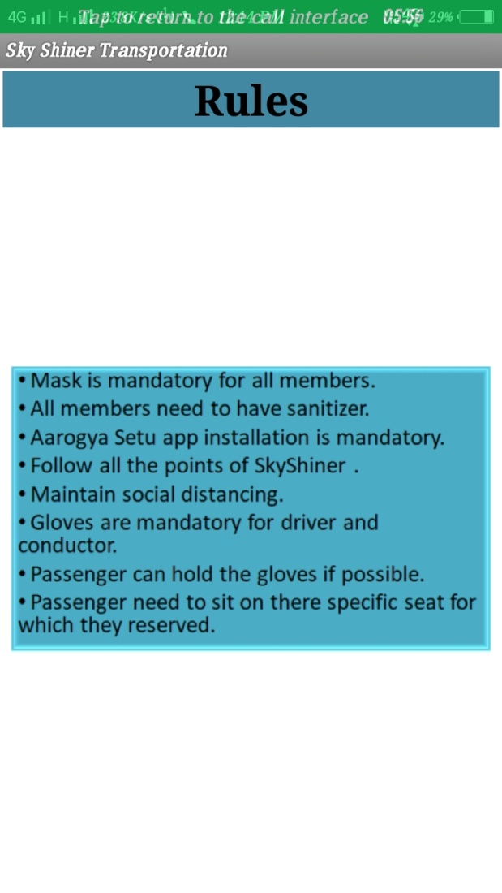
Screen 12
This is the last screen of Sky Shiner Transportation which name is Rules.
When you stay on the Menu Screen and you show some options of the buttons. one button is Rules. When you click on the Rules button then you will able to see the Rule Books of the Sky Shiner Transportation.

Slide 20
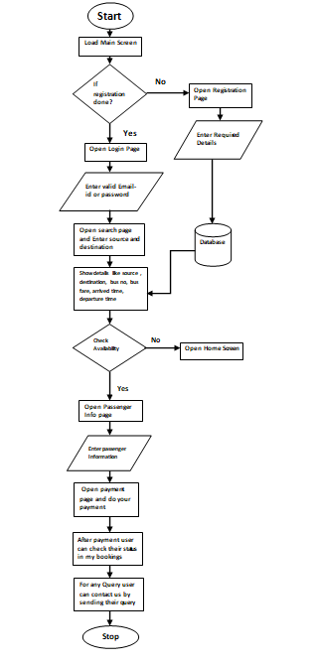
Data Flow Diagram

Slide 21
Advantages & Disadvantages
Advantages
Disadvantages
You can travel with your comfort Zone.
It will provide the surety for the seat.
During COVID-19 it will very beneficial to manage the transportation.
Easy to use.
It will maintain social distance which is very beneficial in this pandemic.
It also provide digital payment system.
we can use it only in the android and Mac phone.
Internet is important.

Slide 22
THANK YOU

